Slide 1

System & Network Administration
By eman mehmood

Slide 2
System & Network Administration
BS Information Technology – 5th Semester
Department of Information Technology
Government College University Faisalabad
Lecture 1: Introduction to System & Network Administration

Slide 3
What Will We Learn Today?
By the end of this lecture, students should understand:
What is System Administration?
What is Network Administration?
Who is a System/Network Administrator?
What is a server?
How do clients and servers communicate?
Why is administration important?

Slide 4

Start With a Question
“Suppose GCUF has thousands of computers, Wi-Fi users, servers, websites, databases and printers. Who makes sure that everything keeps working?”

Slide 5
What is System Administration?
System Administration is the process of:
Installing computer systems and operating systems
Configuring servers
Managing users and accounts
Managing software
Managing storage and files
Monitoring system performance
Troubleshooting problems
Maintaining system security
Managing backups and recovery

Slide 6
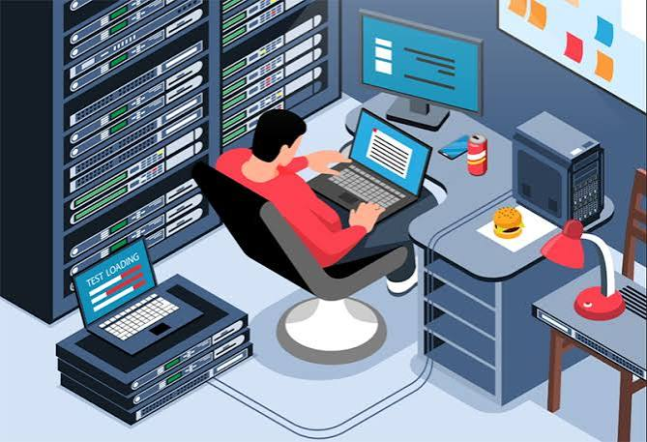
Simple definition:
System administration means managing and maintaining computer systems so they work properly, securely and reliably.

Slide 7
What is Network Administration?
Network Administration involves managing and maintaining computer networks.
A network administrator may manage:
IP addresses, Routers, Switches, Network connections, DNS, DHCP, Firewalls, Network security, Network monitoring, Connectivity problems
Simple definition:
Network administration means managing and maintaining the communication network between computers and devices.

Slide 8
System Administration vs Network Administration
System Administration | Network Administration
Manages computers and servers | Manages networks
Operating systems | Routers & switches
Users and groups | IP addresses
Files and storage | DNS & DHCP
Software | Network security
Processes and services | Network monitoring
Server configuration | Connectivity

Slide 9
Who is a System Administrator?
A System Administrator (SysAdmin) is responsible for keeping an organization's computer systems operational.
Typical responsibilities:
Install operating systems
Configure servers
Create user accounts
Manage permissions
Install software
Monitor systems
Troubleshoot failures
Manage backups
Apply security updates

Slide 10
Who is a Network Administrator?
A Network Administrator manages the organization's network infrastructure.
Responsibilities include:
Configure network devices
Manage IP addressing
Configure DHCP and DNS
Monitor network traffic
Troubleshoot connectivity
Manage firewalls
Maintain network security
Ensure network availability

Slide 11
Why Do Organizations Need Administrators?
Imagine an organization without administrators.
Possible problems:
❌ Servers stop working
❌ Users cannot log in
❌ Internet becomes unavailable
❌ Files may be lost
❌ Software stops working
❌ Security vulnerabilities remain
❌ Network problems are difficult to identify
Therefore:
Administration keeps IT infrastructure available, secure and reliable.

Slide 12
Real-World Example: A University
Think about GCUF..
A university may have:
Computer labs , Student accounts, Faculty accounts, Wi-Fi, Web servers, Email systems
Databases, File servers, Printers, CCTV/network devices, Online portals
Someone has to install, configure, monitor, secure, and troubleshoot these systems.
That's where system and network administration comes in.

Slide 13
What is a Computer Network?
A computer network is a group of connected devices that communicate and share resources.
Examples:
Computers
Laptops
Smartphones
Servers
Printers
Routers
Switches

Slide 14
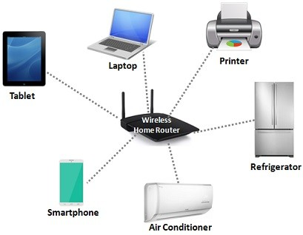
Simple example:
Computer A → Switch → Computer B

Slide 15
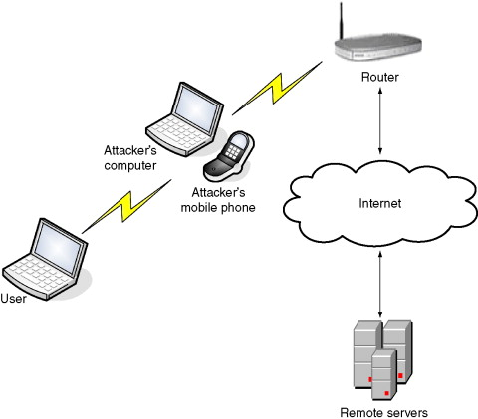
Simple example:
Computer → Router → Internet

Slide 16
What is a Server?
A server is a computer or system that provides services or resources to other computers.
Examples:
Web Server
File Server
Database Server
DNS Server
DHCP Server
Email Server
Application Server
A server is not necessarily a special physical machine.
A powerful computer can act as a server.

Slide 17
What is a Client?
A client is a device or application that requests a service from a server.
For example:
Your Browser → Web Server
You request:
“Give me this webpage.”
The server responds with:
“Here is the webpage.”

Slide 18
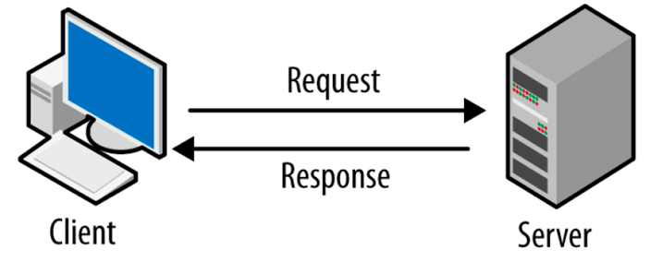
Client–Server Model
Key idea:
Client requests a service → Server provides the service.

Slide 19
Types of Servers
Common server types include:
1. Web Server
Hosts websites and web applications.
2. File Server
Stores and shares files.
3. Database Server
Stores and manages databases.

Slide 20
Types of Servers
4. DNS Server
Translates domain names into IP addresses.
5. DHCP Server
Automatically provides IP configuration.
6. FTP/SFTP Server
Provides file transfer services.

Slide 21
What is an Operating System?
An Operating System (OS) manages computer hardware and software resources.
Examples:
Windows
Linux
macOS
Android

Slide 22


